Slide 1
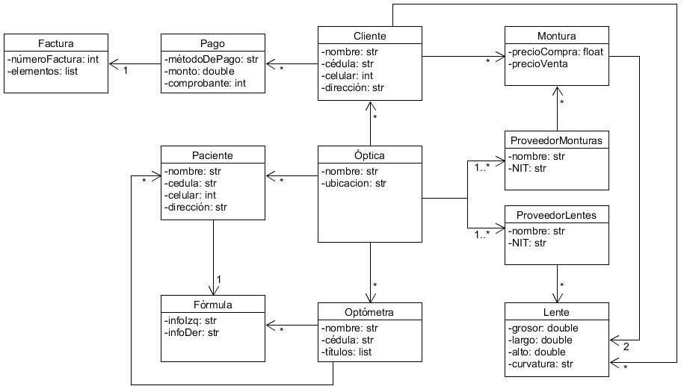
A Playbook for Business Architecture Construction
BAC-09-Metamodelo – Diagrama de clases | Negocio: Óptica | Autor: j.yepes – s.pardog | Fecha: 05/09/2022

